Slide 1
Topics
Instruction count for statements
Methods
Examples

Slide 2
Deriving Instruction Counts
Given a (non-recursive) algorithm expressed in pseudo code we explain how to:
  Assign counts to high level statements
  Describe methods for deriving an instruction count
  Compute counts for several examples

Slide 3
Counts for High Level Statements
Assignment
loop condition
for loop
  for loop body
  for loop control
while loop
  while loop control
  while loop body
if
Note: The counts we use are not accurate; The goal is to derive a correct growth function

Slide 4
Assignment Statement
1. A= B*C-D/F
Count₁ = 1
In reality? At least 4
Note: When numbers B, C, D, F are very large, they may be stored in arrays of length greater than 1.
Algorithms that deal with large numbers will be used and the count will depend on the number of digits needed to store the large numbers.

Slide 5
Loop condition
(i < n)&&(!found)
Count₁ = 1
Note: if loop condition invokes functions, count of function must be used
Note: The subscript 1 for Count denotes the instruction number

Slide 6
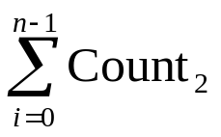
for loop body
for (i=0; i < n; i++)
A[i] = i
Count₂ = 1
Count₁₍₂₎ =
How many times is condition satisfied?
i = 0
i < n
false
true
A[i] = i
i = i + 1

Slide 7
for loop control
for (i=0; i < n; i++)
<body>
Count = number
times loop
condition is
executed
(assuming loop condition has a count of 1)
i = 0
i < n
false
true
Body of
the loop
i = i + 1

Slide 8
for loop control
for (i=0; i < n; i++)
<body>
Count₁ = number times loop condition i < n is executed
= n + 1
Note: last time condition is checked i =n and (n < n) evaluates to false
i = 0
i < n
false
true
Body of
the loop
i = i + 1

Slide 9
while loop control
i = 0
while (i < n){
A[i] = i
i = i + 1}
Count = number
times loop condition
is executed (assuming loop condition has a count of 1)
i = 0
Line 1
Line 2
i < n
false
true
A[i] = i
Line 3
i = i + 1
Line 4

Slide 10
while loop control
i = 0
while (i < n){
A[i] = i
i = i + 1}
Count₂ = number times loop condition
(i < n) is executed
= n + 1
i = 0
Line 1
Line 2
i < n
false
true
A[i] = i
Line 3
i = i + 1
Line 4

Slide 11
If statement
Line 1: if (i == 0)
Line 2: statement
else
Line 3: statement
For worst case analysis, what is Count_{if} ?
Count_{if} = 1 +max{count2, count3}

Slide 12
Method 1: Sum Line Counts
Derive a count for each line of code taking into account all loop nesting.
Compute total by adding line counts.

Slide 13
Method 2: Barometer Operation
A “barometer instruction” is selected
Count = number of times that barometer instruction is executed.
Search algorithms:
  barometer instruction (x == L[j]?).
Sort algorithms:
  barometer instruction (L[i] == L[j]?).

Slide 14
Example 1
1. for (i=0; i<n; i++ )
2. A[i] = i
Method 1
count₁= n+1
count₁₍₂₎ = n*1 = n
_________________
Total = (n+1)+n = 2n+1

Slide 15
Example 1 continued
Method 2
1. for (i=0; i<n; i++ )
2. A[i] = i + 1
Barometer operation = + in body of loop
count₁₍₊₎ = n

Slide 16
Example 2: What is count₁₍₂₎?
1.for (i=1;i<=n;i=3*i)
2. A[i] = i
i = 1
Line 1
Line 1
i <= n
no
yes
A[i] = i
Line 2
i = 3* i
Line 1

Slide 17
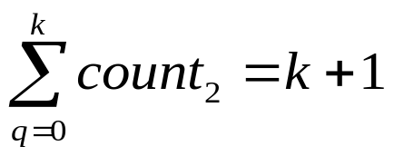
Example 2: What is count₁₍₂₎?
1. for(i=1;i<=n; i=3*i)
2. A[i] = i
For simplicity,
n = 3^{k} for some positive integer k.
Body of the loop executed for
i = (1=3⁰), 3¹, 3²,…,3^{k}.
So count₁₍₂₎=
Since k = log₃n, it is executed log₃n + 1 times.
i = 1
Line 1
Line 1
i <= n
no
yes
A[i] = i
Line 2
i = 3* i
Line 1

Slide 18
Example 3:
Sequential Search
1. location=0
while (location<=n-1
&& L[location]! = x)
4. location++
5. return location
Barometer operation = (L[location]! = x?)
Best case analysis
Worst case analysis
x == L[0] and the count is 1
  x = L[n-1] or x not in the list. Count is n.

Slide 19
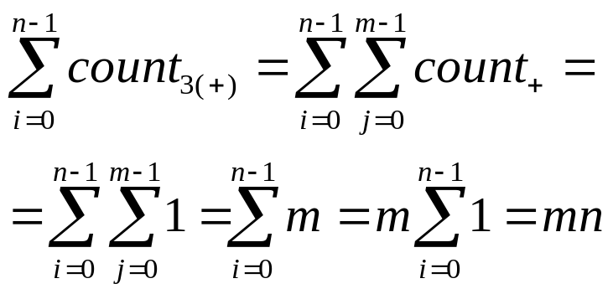
Example 4:
1. x = 0
2. for (i=0; i<n; i++)
3. for (j=0, j<m; j++)
4. x = x + 1
Barometer is + in body of loop.
count₂₍₃₍₊₎₎₎ = ?

Slide 20
Flowchart for example 4
x = 0
Line 1
i = 0
Line 2
Line 2
i < n
false
j = 0
Line 3
i = i + 1
j < m
false
Line 3
j = j + 1
x = x + 1
Line 4

Slide 21
Example 5:
x=0
for (i=0; i<n; i++)
for (j=0, j<n²; j++)
x = x + 1
The body of the loop of line 2 is executed ?
The body of the loop of line 3 is executed ?
Count₂₍₃₍₊₎₎= ?
Answer: n*n²*1

Slide 22
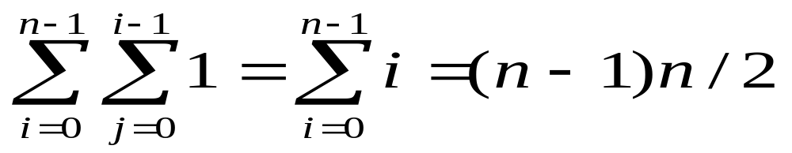
Example 6:
  Line 1: for (i=0; i<n; i++)
  Line 2: for (j=0, j<i; j++)
  Line 3. x = x + 1
  Barometer = +
  Count₁₍₂₍₊₎₎= ?

Slide 23

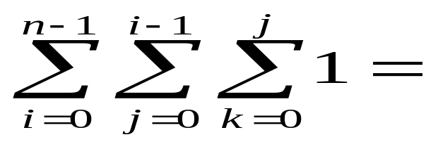
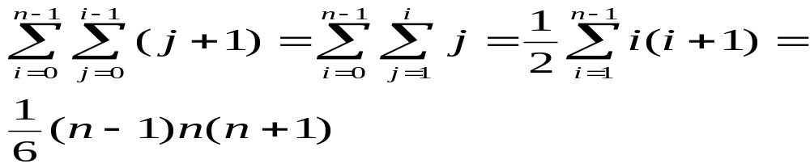
Example 7:
1. for (i=0; i<n; i++)
2. for (j=0, j<i; j++)
for (k=0; k<=j; k++)
countMe
count₁₍₂₍₃₎₎=

Slide 24


Example 8
Line 1: j = n
Line 2: while (j > 0) {
Line 3: CountMe
Line 4: j = j-2;
}
Line 3 is executed for j= n, n-2, ....
If n is even the last time would be for n=2, and the answer is n/2=
If n is odd the last time would be for n=1, and the answer is

